Slide 1
LSDM
Project Trace
Group 6
Nicholas Ray, Jeff Dong, Hezron Perez, Benjamin Parrish

Slide 2
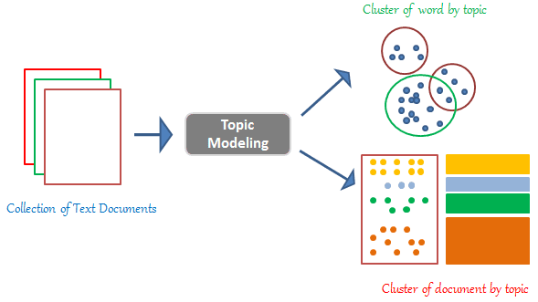
Stage 1: Topic Modeling
Image Source: https://www.analyticsvidhya.com/blog/2021/07/topic-modelling-with-lda-a-hands-on-introduction/

Slide 3

Topic Modeling:
Libraries Used
Pandas (Dataframes & Data Exploration)
Gensim (Open-source Topic Modeling)
Nltk (Natural Language Toolkit)
pyLDAvis (Interactive Visualization)

Slide 4
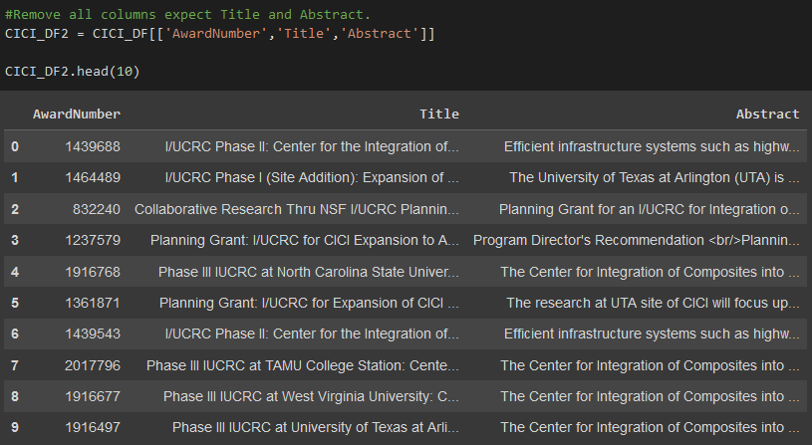
Topic Modeling:
Data Exploration

Slide 5
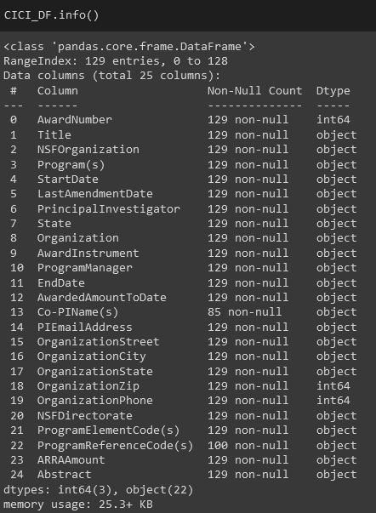
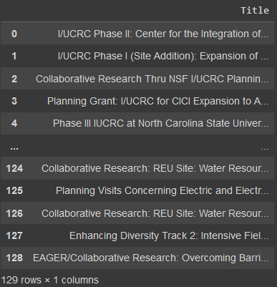
Topic Modeling:
Data Exploration

Slide 6
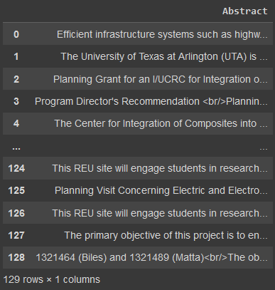
Topic Modeling:
Data Exploration

Slide 7
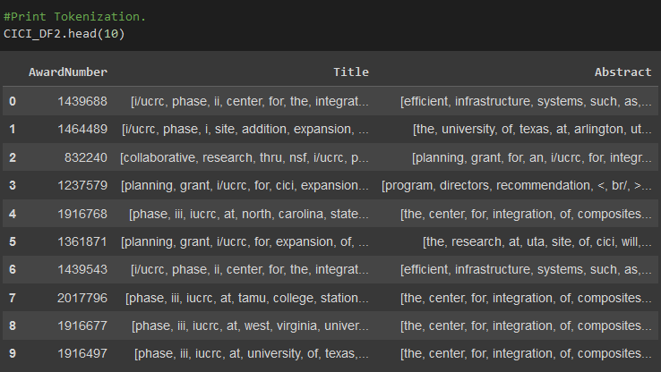
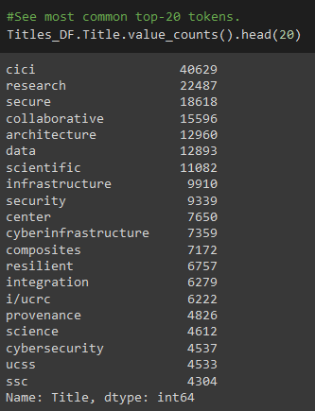
Topic Modeling:
Data Tokenization

Slide 8
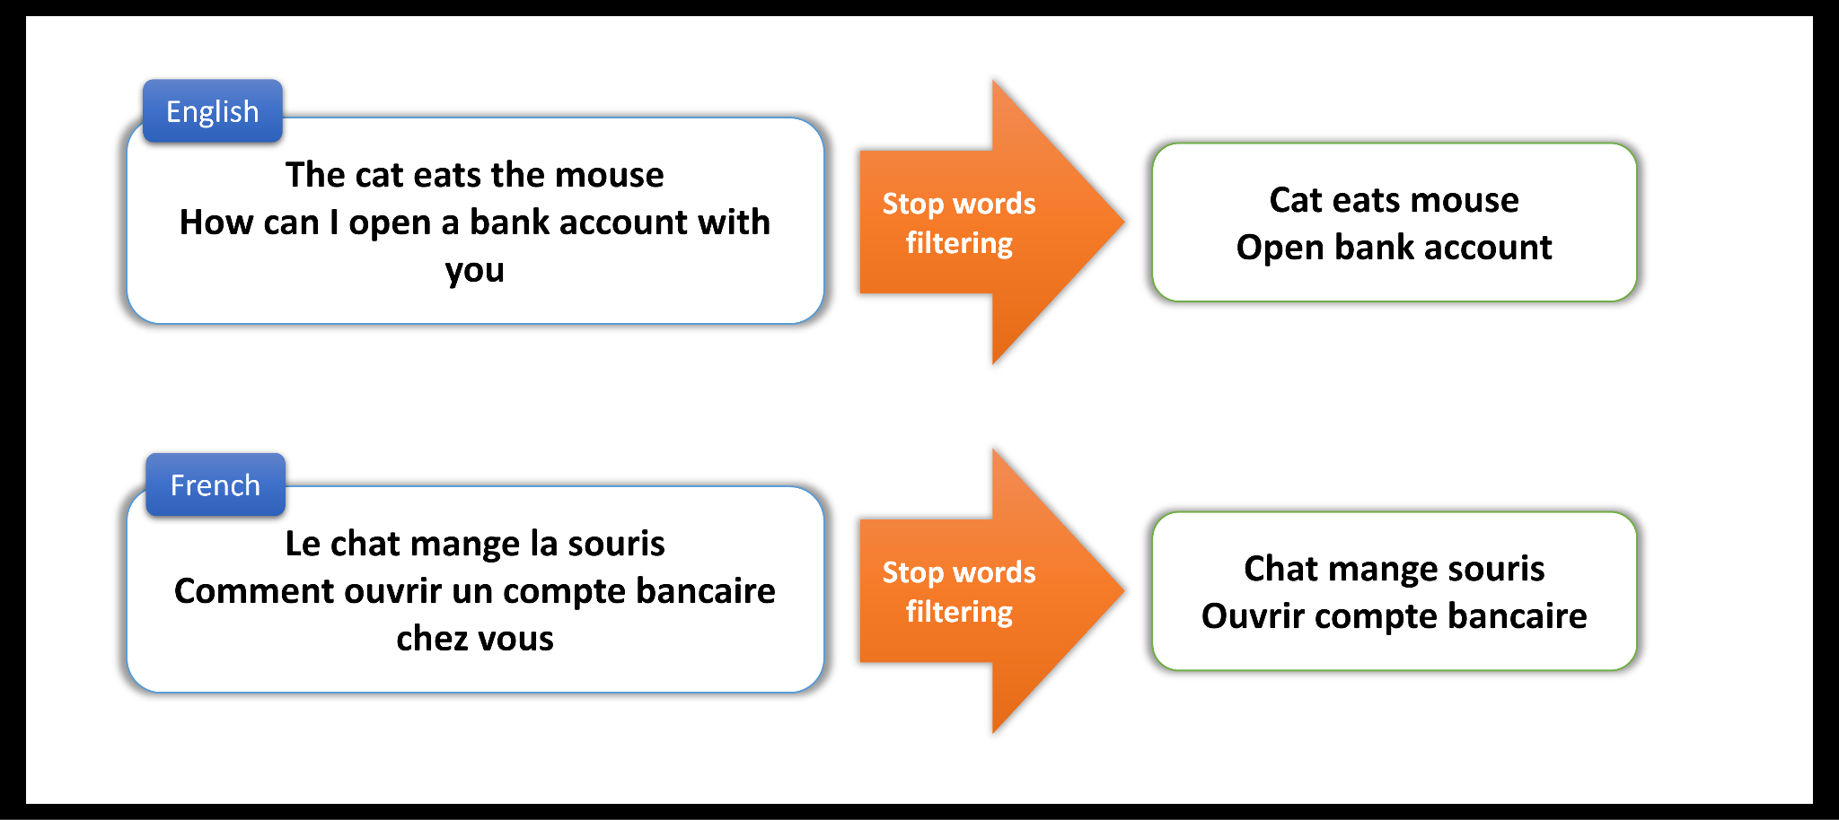
Topic Modeling:
Stop Words Filtering
Image Source: https://docs.smartly.ai/docs/stop-words-filtering

Slide 9
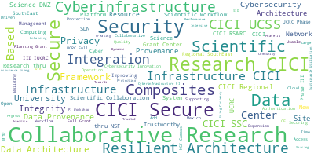
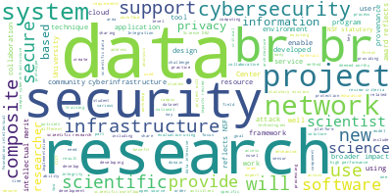
Topic Modeling:
Word Clouds
Titles
Abstracts

Slide 10
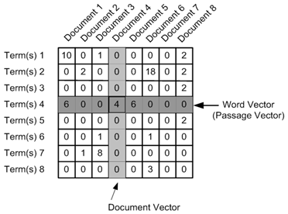
Topic Modeling:
Data Vectorization
Image Source: https://www.analyticsvidhya.com/blog/2021/06/part-5-step-by-step-guide-to-master-nlp-text-vectorization-approaches/

Slide 11
Topic Modeling:
Data Vectorization
['ucrc', 'phase', 'ii', 'center', 'integration', 'composites', 'infrastructure', 'cici']
[(0, 1), (1, 1), (2, 1), (3, 1), (4, 1), (5, 1), (6, 1), (7, 1)]

Slide 12
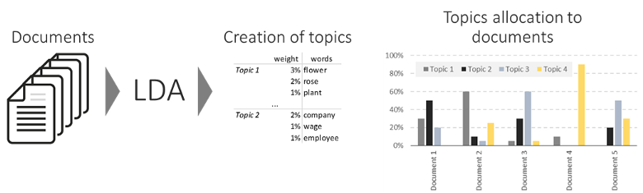
Topic Modeling:
Model Training
Image Source: https://www.kdnuggets.com/2019/09/overview-topics-extraction-python-latent-dirichlet-allocation.html

Slide 13

Topic Modeling:
Model Training
# Number of topics
num_topics = 10
# Build LDA model
lda=gensim.models.LdaModel(corpus=title_corpus,id2word=title_word,num_topics=num_topics)
lda2=gensim.models.LdaModel(corpus=abstract_corpus,id2word=abstract_word,num_topics=num_topics)
Image Source: https://www.aihr.com/blog/learning-vs-training/

Slide 14

Topic Modeling:
Keywords Export
Keywords Set
Keywords Text File
['ssc', 'composites', 'br', 'nsf', 'platform', 'iii', 'ucss', 'data', 'pi', 'phase', 'southeast', 'collaborative', 'practice', 'secure', 'scientific', 'research', 'privacy', 'evaluation', 'riviera', 'cybersecurity', 'supporting', 'cici', 'open', 'project', 'network', 'university', 'enhancing', 'access', 'cilogon', 'computing', 'software', 'based', 'workshop', 'programming', 'systems', 'architecture', 'driven', 'campus', 'scientists', 'provenance', 'rdp', 'resource', 'cloud', 'iucrc', 'integration', 'science', 'scitrust', 'infrastructure', 'center', 'building', 'composite', 'resilient', 'management', 'framework', 'security']

Slide 15
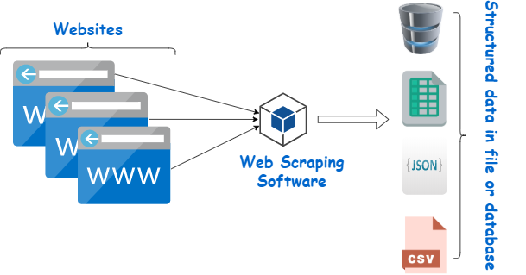
Stage 2: Web Scraping
Image Source: https://www.webharvy.com/articles/what-is-web-scraping.html

Slide 16

Web Scraping:
Libraries Used
BeautifulSoup (Web Scraping & Text Mining)
Googlesearch (Open-source Topic Modeling)
Mongoimport (Cmd Line MongoDB)
Json (Json Creation & Manipulation)
Datetime (Date & Time)

Slide 17
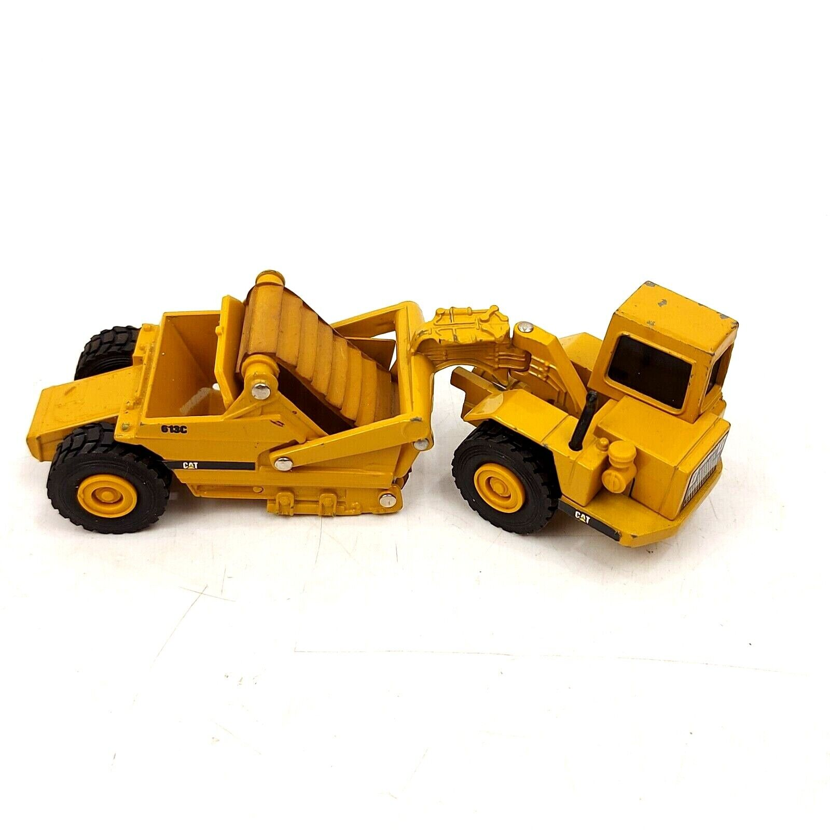

Web Scraping:
Process
Keywords Text File
Json Files
Web Scraper

Slide 18


Web Scraping:
Queries
Keywords Text File
Award + Keyword
BeautifulSoup

Slide 19
Web Scraping:
Query Processing
BeautifulSoup
json_dict = {
'Award': str(award),
'keyword': str(keyword),
'title': str(soup.title),
'text': str(soup.p),
'raw html': soup.get_text()}

Slide 20
Web Scraping:
Query Processing
Json Files
json_dict = {
'Award': str(award),
'keyword': str(keyword),
'title': str(soup.title),
'text': str(soup.p),
'raw html': soup.get_text()}
json_object = json.dumps(json_dict, indent=5)

Slide 21
Web Scraping:
Database Import
Json Files
SHH → Bash Shell
(mongoimport)

Slide 22

Challenges
Image Source: https://www.villanovau.com/resources/project-management/project-management-challenges/

Slide 23
Challenges:
Topic Modeling
#Tokenization.
def clean_text(text):
text = text.replace("'", '')
text = text.replace(",", '')
text = text.replace(":", '')
text = text.replace(")", '')
text = text.replace("(", '')
text = text.lower()
text = re.sub(r'\s+', ' ', text)
text = text.strip()
return text
Data Cleaning & Tokenization
Data Preparation for Model Input

Slide 24
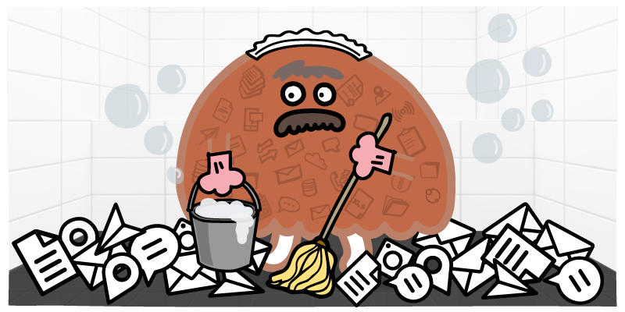
Challenges:
Web Scraping
HTML Parsing
HTML → Json Conversion
SSH Shell & mongoimport
Image Source: https://blog.insycle.com/what-is-dirty-data

Slide 25
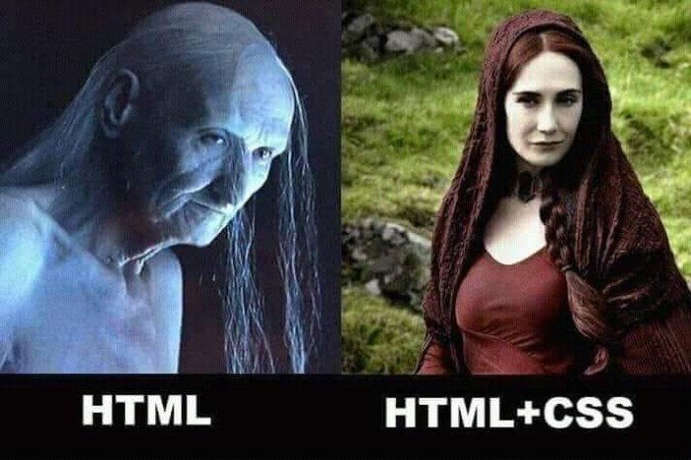
Challenges:
Web Scraping

Slide 26


Challenges:
Web Scraping
HTML Files
Json Files

Slide 27
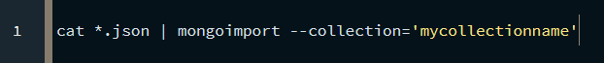
Challenges:
Web Scraping
Code Source: https://www.mongodb.com/developer/products/mongodb/mongoimport-guide/

Slide 28
The Database
Technical Summary of Database Used on Project.

Slide 29
Project Requirements
Requirements of Topic modeling determined our choices in the database solution we settled on
Topic modeling required flexible setup & ability to efficiently use large amount of unstructured data
Ultimately NO-SQL database proved to be the most expedient option
MongoDB was chosen due to all members being familiar with it.

Slide 30
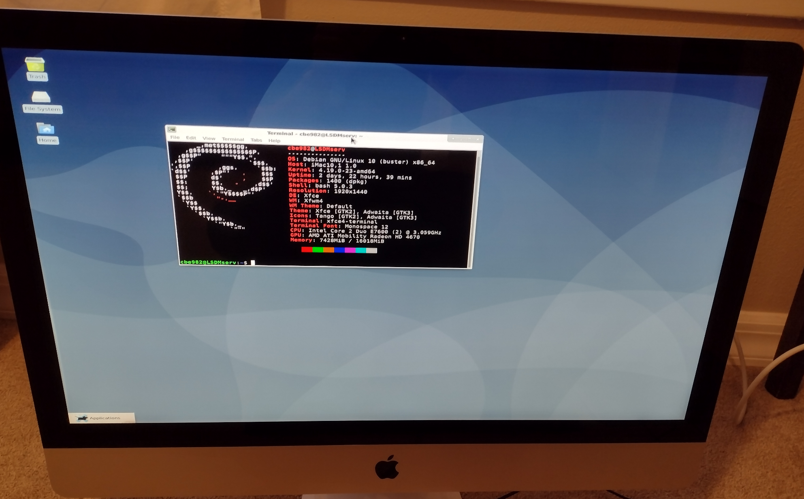
The Machine
Original Plan was to host database on arcnet
Plan abandoned due to problems installing mongodb
Unable to access package manager
Extensive issues trying to compile from source
Machine being used to host server is iMac10
CPU: Intel Core 2 Duo
Memory: 16GB
OS: Debian 10

Slide 31
Networking
Use of local machine required network configuration
Opened port 2222 for SSH connection
Opened port 27017 for Website to query data from database

Slide 32

MongoDB
Documentation readily available
Relatively easy to install on server
Instructions available on MongoDB website
All team members were familiar with it due to class lectures
Simple interface to website
Version 4.4 was used
more recent versions are not supported by host

Slide 33
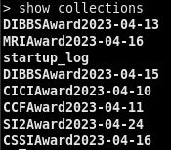
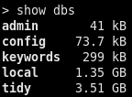
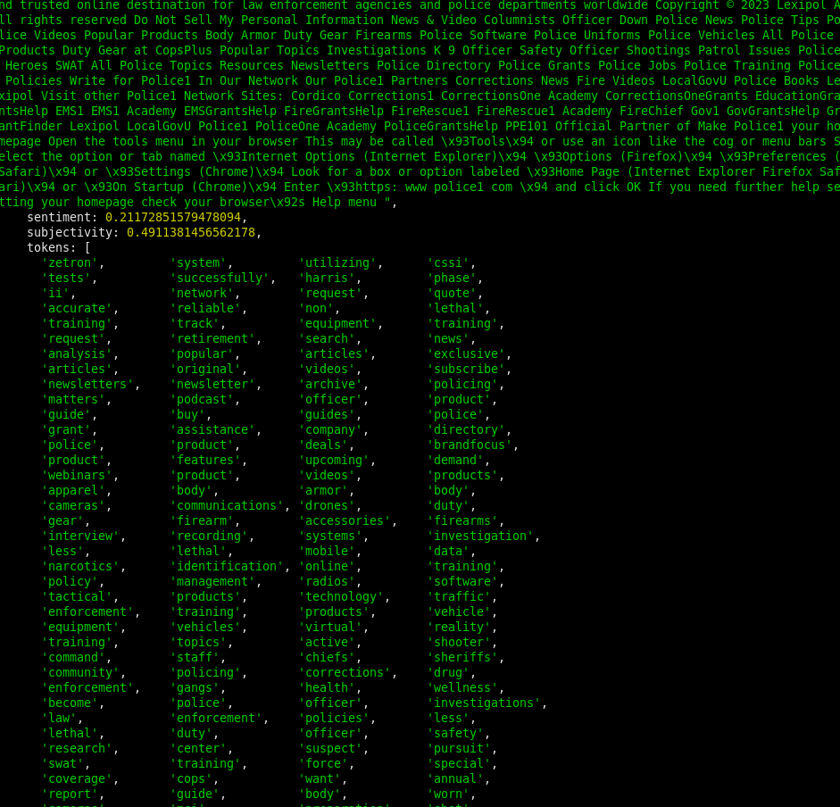
Data Organization
“local” database stores scraped html
Each Award was sorted into its own collection
“tidy” database stores outputs from topic modeling scripts
As in local each award sorted to own collection
Contains cleaned html, sensitivity & subjectivity scores, and list of tokens.

Slide 34
Problems and Opportunities for improvement
Security
Database secured by simple username+password combination
Less secure than using ssh keys or authorized IP addresses
Access control not implemented in database itself
Redundancy
No Data Replication is being performed
In the event of a catastrophic server failure, all restoration must be done manually, causing extensive downtime
Implementing some form of replication and rapid recovery
Complicated and difficult on single local machine
Hardware
Macintosh is not an optimal machine for long term hosting
Needs regular restarts creating short periods of downtime
Hosting on cloud service outsources this problem

Slide 35

Database Cleaning & Insights
Image Source: https://www.grantbook.org/blog/how-to-clean-your-data-hygiene-best-practices

Slide 36

Database Cleaning:
Libraries Used
Pymongo, SSH_Pymongo (Connecting, writing, updating DBs)

Slide 37
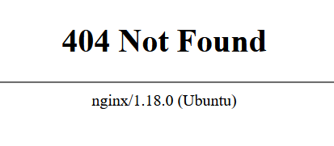
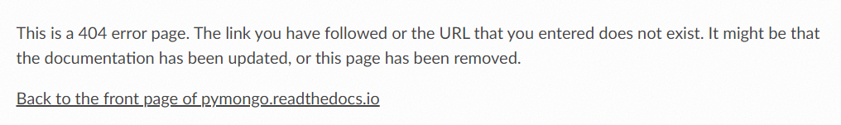
Database Cleaning:
Identifying Bad Pages

Slide 38
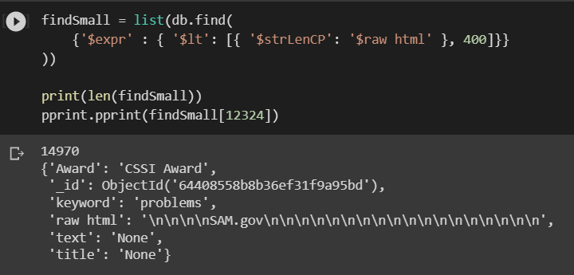
Database Cleaning:
Identifying Bad Pages
Too small!!!

Slide 39
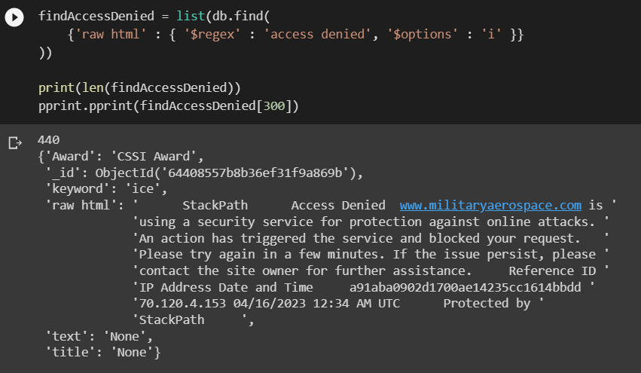
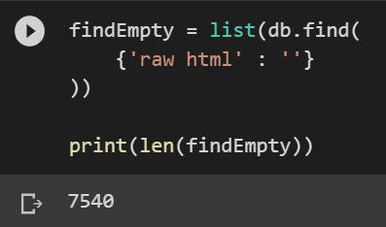
Database Cleaning:
Identifying Bad Pages

Slide 40
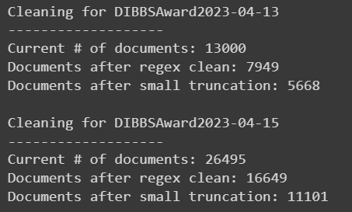
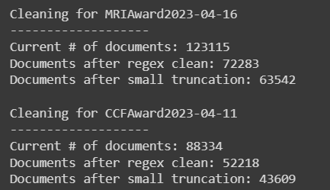
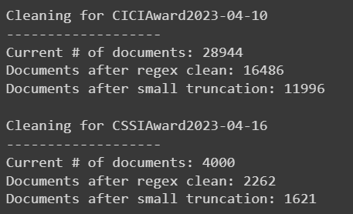
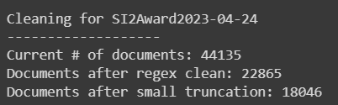
Database Cleaning:
Removing Bad Pages

Slide 41

Sentiment & Tokenizing:
Libraries Used
Pymongo, SSH_Pymongo (Connecting, writing, updating DBs)
Pandas (Dataframes & Data Exploration)
TextBlob (Sentiment analysis)
Gensim (String pre-processing)
Nltk (Natural Language Toolkit)

Slide 42
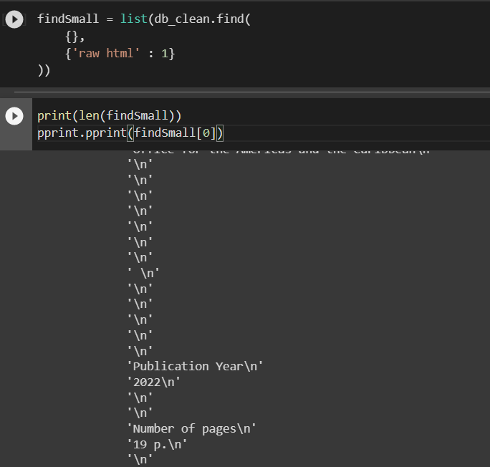
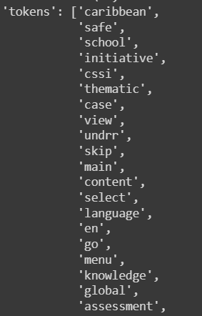
Database Tokenizing:
Cleaning up the HTML

Slide 43
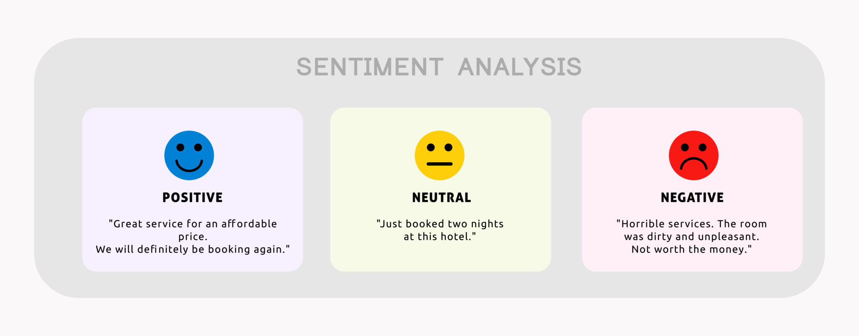
Sentiment Analysis:
Choosing a model
Image Source: https://www.expressanalytics.com/blog/social-media-sentiment-analysis/

Slide 44


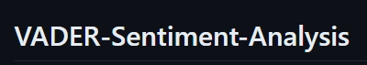
Sentiment Analysis:
Choosing a model

Slide 45
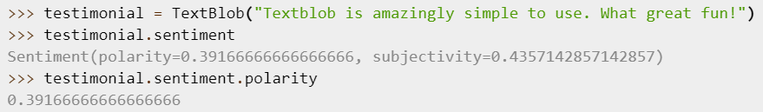
Sentiment Analysis:
Choosing a model

Slide 46

Topic Modeling:
Libraries Used
Pymongo, SSH_Pymongo (Connecting, writing, updating DBs)
Pandas (Dataframes & Data Exploration)
Gensim (Open-source Topic Modeling)
Nltk (Natural Language Toolkit)
pyLDAvis (Interactive Visualization)

Slide 47
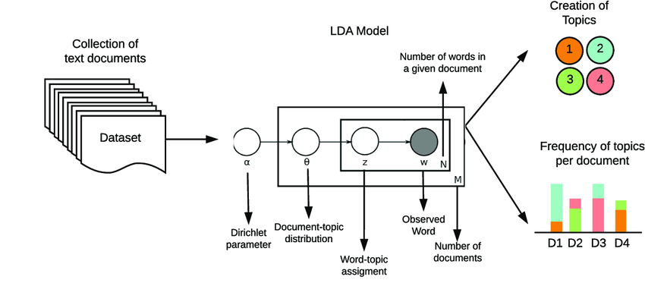
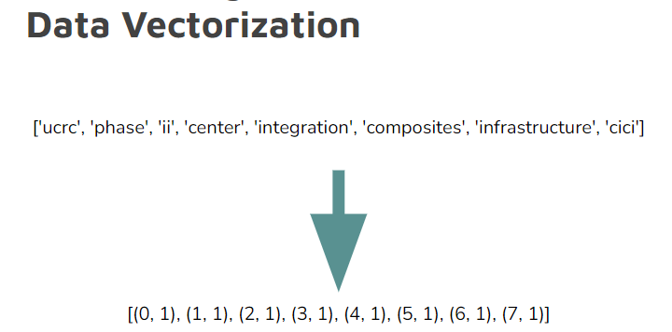
Topic Modeling:
Preparing the data
Tokenization already done!
Image Source: https://www.analyticsvidhya.com/blog/2021/06/part-2-topic-modeling-and-latent-dirichlet-allocation-lda-using-gensim-and-sklearn/

Slide 48
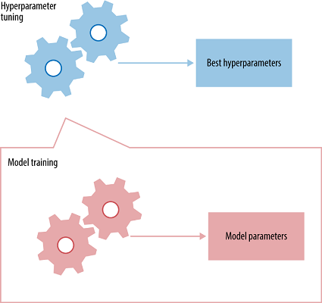
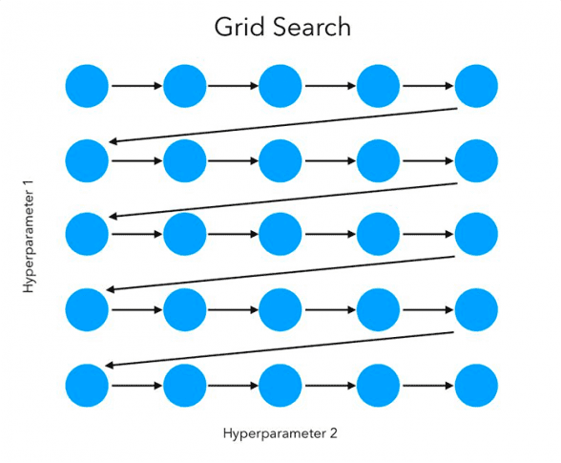
Topic Modeling:
Parameter Optimization
Image Source: https://pyimagesearch.com/2021/05/24/grid-search-hyperparameter-tuning-with-scikit-learn-gridsearchcv/
https://towardsdatascience.com/hyperparameter-tuning-the-random-forest-in-python-using-scikit-learn-28d2aa77dd74

Slide 49
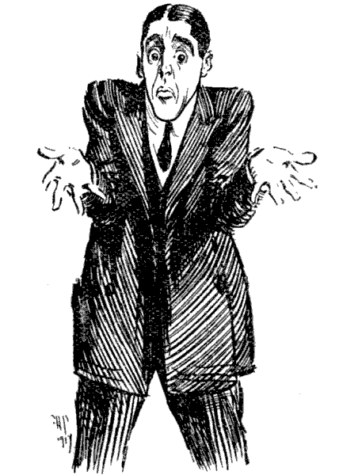

Topic Modeling:
Perplexity vs Coherence

Slide 50
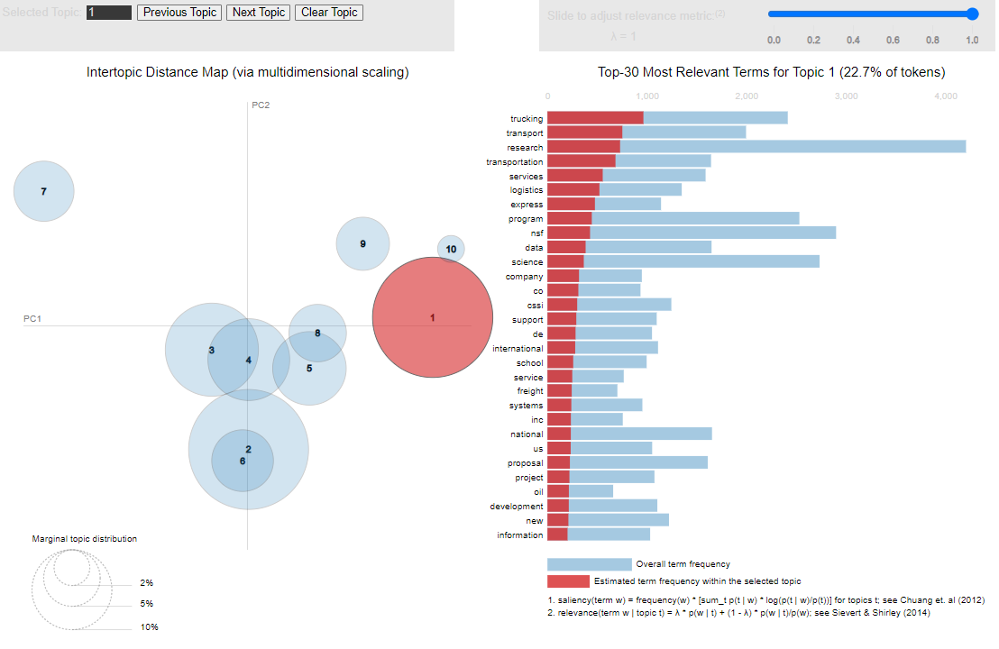
Topic Modeling:
Keyword LDA Visualization

Slide 51
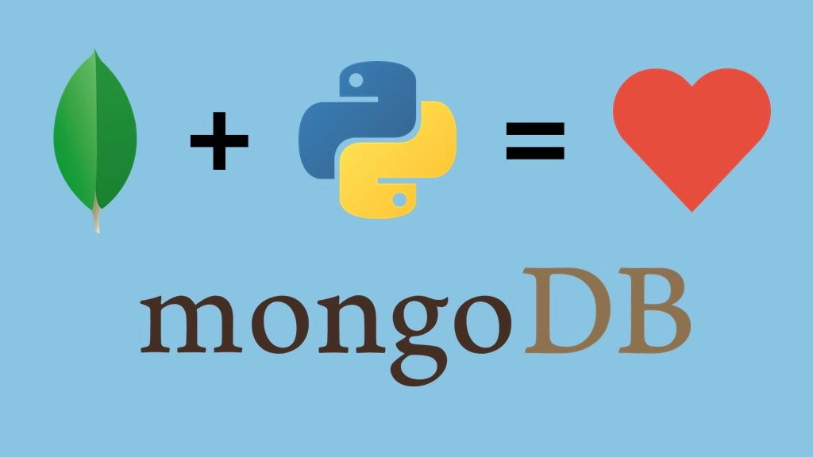
And finally…
Upload and update to the DB!

